Slide 1
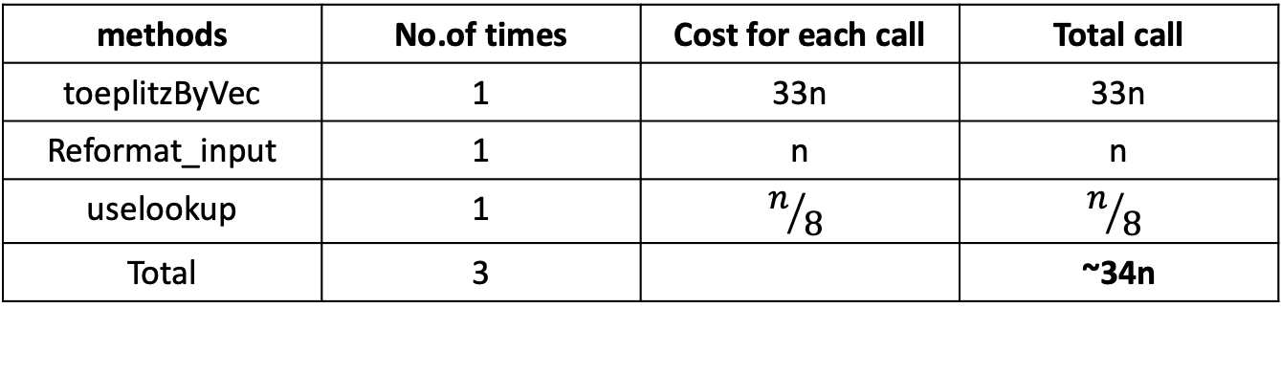
Centralized wPRF (packed + lookup table)
Files:
test_packed_PRF_central_lookup.cpp
lookup_functions.cpp
PackedMod2.hpp
methods | No.of times | Cost for each call | Total call
toeplitzByVec | 1 | 33n | 33n
Reformat_input | 1 | n | n
uselookup | 1 | $$n/8$$ | $$n/8$$
Total | 3 |  | ~34n

Slide 2
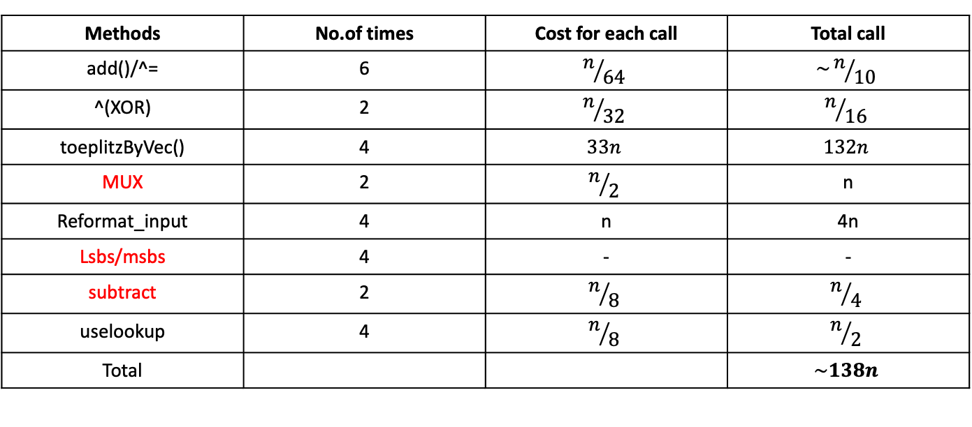
DIDO(Fully Distributed with packed and lookup)
Files:
new_protocol.cpp
lookup_functions.cpp
PackedMod2.hpp
PackedMod3.hpp
Methods | No.of times | Cost for each call | Total call
add()/^= | 6 | $$n/{64}$$ | $$\sim n/{10}$$
^(XOR) | 2 | $$n/{32}$$ | $$n/{16}$$
toeplitzByVec() | 4 | $$33n$$ | $$132n$$
MUX | 2 | $$n/2$$ | n
Reformat_input | 4 | n | 4n
Lsbs/msbs | 4 | - | -
subtract | 2 | $$n/8$$ | $$n/4$$
uselookup | 4 | $$n/8$$ | $$n/2$$
Total |  |  | $$\sim 138n$$

Slide 3

DIDO(Fully Distributed with packed)
party1_round_1: 9 operations
Party2_round_1: same
Both K, $Rk_{1}$ are Toeplitz

